Slide 1
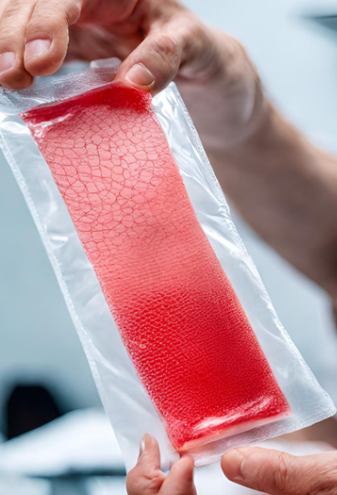

Heal faster, live longer

Slide 2
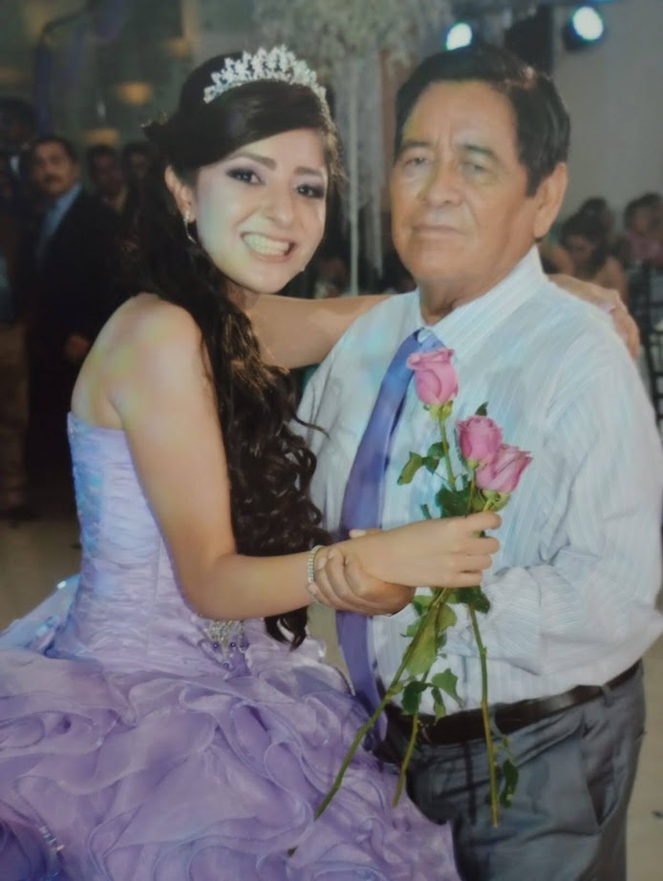
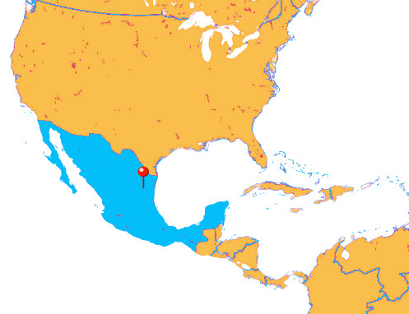

Abi’s Grandpa 75 years old, Male with Diabetes type II and toe amputated
Amputations in public Hospitals in Mexico, increase the chances of dying in the following 5 years by 1.5 times.
Source: SciELO
Complication in wounds
Amputations
Notes:
Hi, im Abil. This is my grandpa. He is 75 years old.
We loved to dance together, but now we can’t cause he got his toes amputated. He has diabetes, got a wound in one of his toes. With diabetes wounds don’t heal easily because of poor circulation, also he doesn’t feel pain, so it is common that something is damaging and increasing the wound without him knowing.
After his first toe got amputated, it took 7 months for it to heal. It is stadisticall

Slide 3


Problem
$1B
$80/day
5.5M
Costs of ulcers and related treatments in 2020 in the U.S.
Average daily cost for per ulcers patient in the U.S.
Americans >65 y.o. with
diabetes develop a foot ulcer
during their lifetime
Every 3 minutes and 30 seconds in the United States, a limb is amputated due not well treated diabetic ulcer.
Notes:
>15 millions Mexican >60 yo suffer for diabetic
Just as my grandpa, 5.5 M of elderly American suffers from diabetic foot ulcers. The annual cost for this is 1 Billion dollars, and treating the ulcers per day is about 80 dollars. As a matter of fact, every 3 minutes and 30 seconds in the US, a limb is amputated because of diabetes.

Slide 4
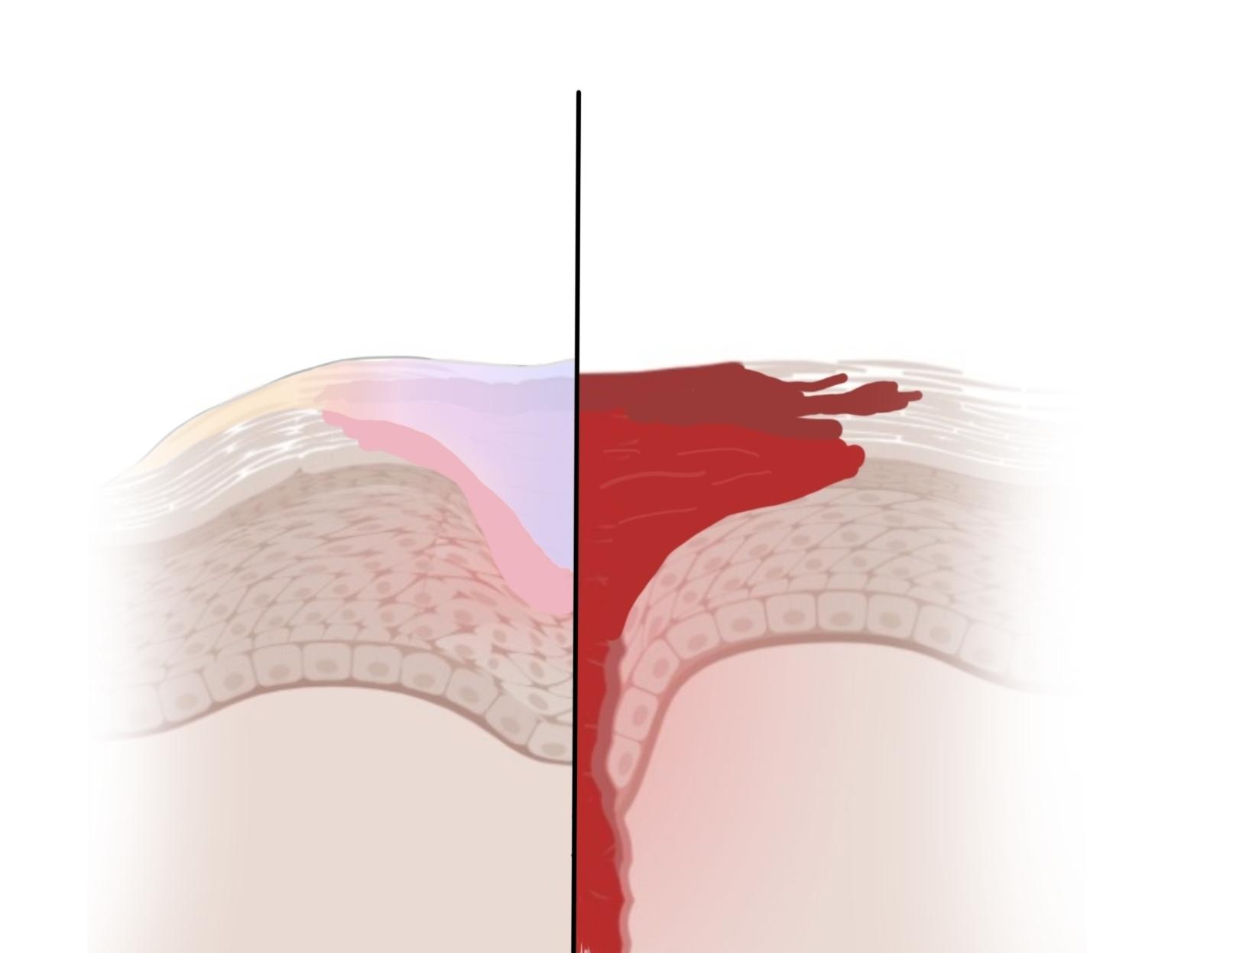
Conventional Treatment
Prevent wound progression
Promote regeneration
Infection color indicator
Pressure sensor
Easy to use
Just waterproof and remain inert
Maintain hydration at the wound
Need to be treated by a wound care nurse
$9/day
$80/day
Notes:
Introducing…. Diapatch. An easy to use hydrogel patch that promotes faster healing for diabetic ulcers
, Phenol red: When pH increased, the color of the hydrogel patches will transit from yellow (pH 5-7) to orange (7.4-8), and finally to red (pH 9).
Results: A total of 319 wound episodes in 248 patients were captured. Patients required an average of 2.6 6 0.2 inpatient admissions and 0.9 6 0.1 outpatient procedures to achieve complete healing. Limb salvage at 1 year was 95.0% 6 2.4%. The overall mean cost of care per wound episode was $24,226 6 $2176, including $41,420 6 $3318 for inpatient admissions and $11,265 6 $1038 for outpatient procedures. The mean net margin was $2412 6 $375 per wound episode, including $5128 6 $622 for inpatient admissions and a net loss ($3730 6 $596) for outpatient procedures. Mean time to wound healing was 136.3 6 7.9 days, ranging from 106.5 6 13.1 days for WIfI stage 1 wounds to 229.5 6 20.0 days for WIfI stage 4 wounds (P < .001). When adjusted for days of care, the net margin ranged from $2.6 6 $1.3 per day (WIfI stage 1) to $23.6 6 $18.8 (WIfI stage 4).
https://www.jvascsurg.org/article/S0741-5214(18)32559-X/pdf

Slide 5
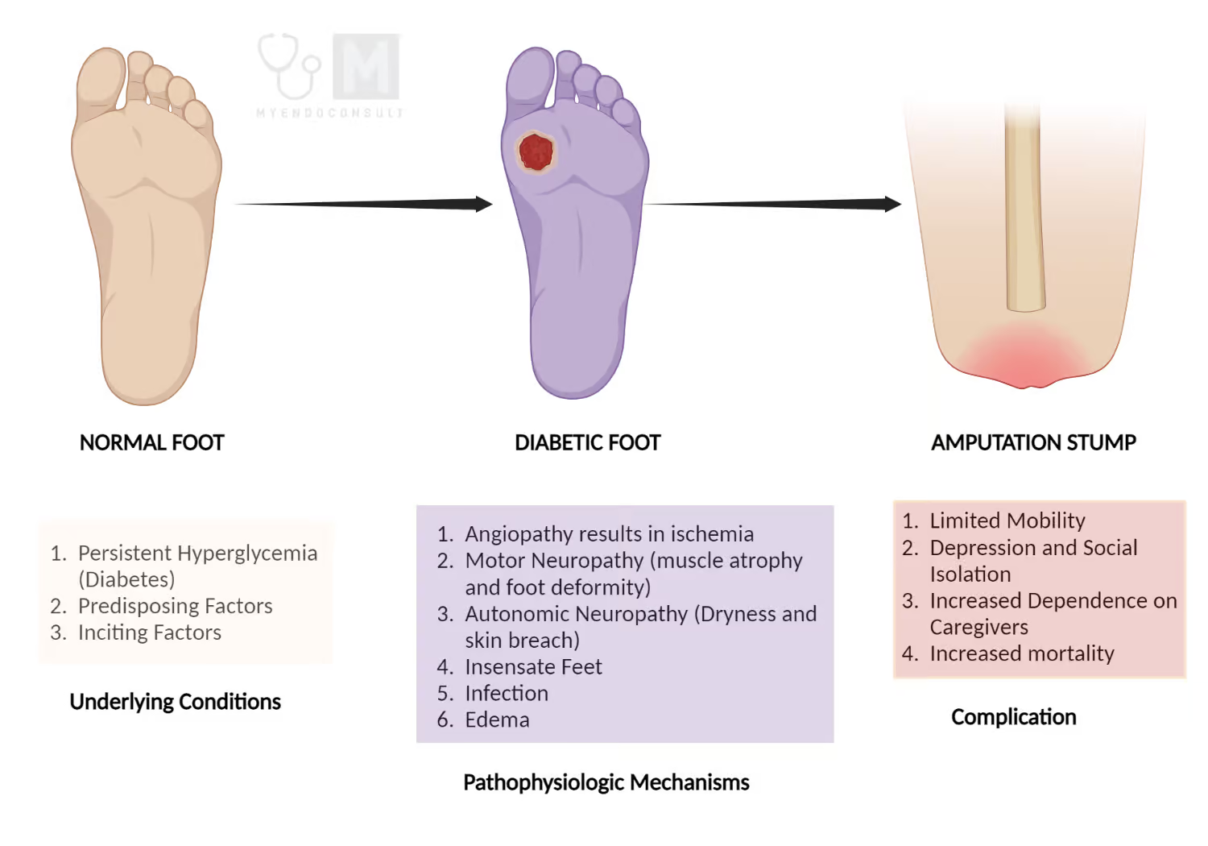
HEALTHY FOOT
DIABETIC ULCER

Slide 6


Infection Indicator
High
Low
Avoid further complications through regeneration
*Need to change
the patch
HEALTHY FOOT
DIABETIC ULCER
Regeneration
Zhao, H., Wu, Y., Xie, Y., Li, Y., Chen, C., Li, C., Yang, F., Zhang, D., Wang, Y., & Yuan, J. (2024). Hydrogel dressings for diabetic foot ulcer: A systematic review and meta‐analysis. Diabetes, Obesity & Metabolism/Diabetes, Obesity and Metabolism. https://doi.org/10.1111/dom.15544
‌

Slide 7
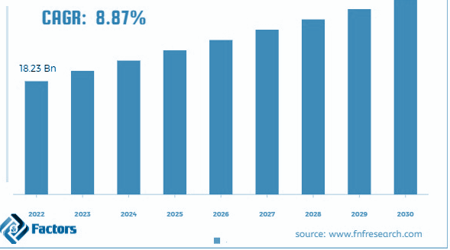
Global Diabetes Management Market
Demand
+14 Bn Market cap this decade
Mexico Subsidizes 4.5 Bn annually for Diabetes
US Subsidizes 237 Bn annually for Diabetes
Source: Facts & Factors, Insights10, The Asian Post, Hospital management Asia, CDC
Notes:
A hydrogel patch that promotes faster healing with regenerative, antiseptic properties, that monitor wound progression via pH change, invasive pressure on the ulcer.
Phenol red: When pH increased, the color of the hydrogel patches will transit from yellow (pH 5-7) to orange (7.4-8), and finally to red (pH 9).

Slide 8
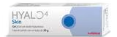

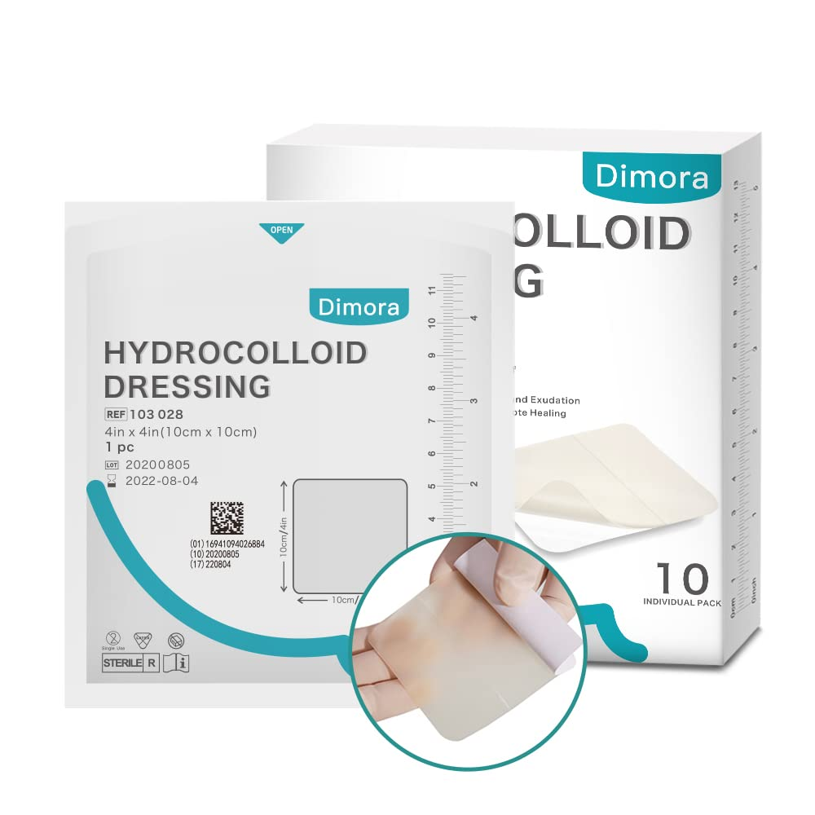

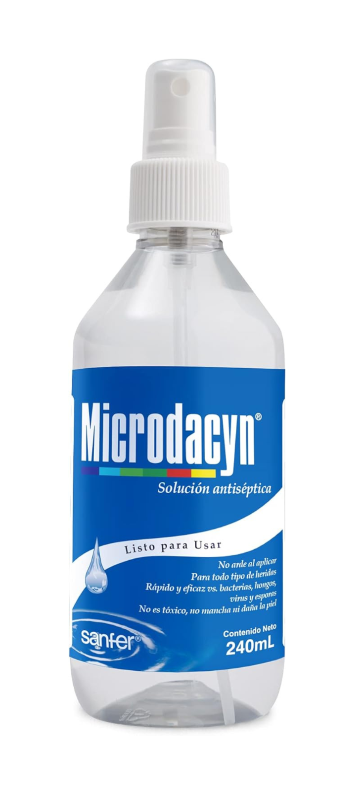
Competitive Landscape
Competitor price weekly: $560
Our price per week: $60
Faster Healing
WIth hydrogel
No
Yes
Infection Monitoring
Without hydrogel

Slide 9

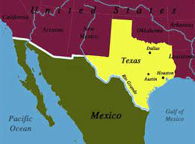
Business Model
Expand to US starting in Texas and Indiana converting to B2B in to Insurance
Start in Mexico City B2G with grants, investors, and network in Pfizer and 3M
Projected Startup Cost: $250,000
Projected Cost: $13/patch
Projected Cost: $3/patch
Notes:
A hydrogel patch that promotes faster healing with regenerative, antiseptic properties, that monitor wound progression via pH change, invasive pressure on the ulcer.
Phenol red: When pH increased, the color of the hydrogel patches will transit from yellow (pH 5-7) to orange (7.4-8), and finally to red (pH 9).

Slide 10



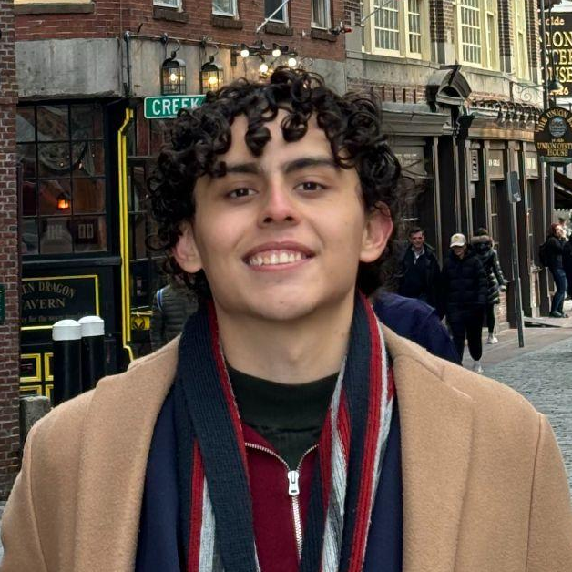






The Team
Thank you
Strong founding team with diverse experiences in healthtech institutions and companies from various countries
Vickry A Ghufron
Medical Doctor
Digital Health UCL
Strategic Management Oxford
Abigail Herrera Ruiz
Nanotechnologist
Harvard Medical School BWH
Ricardo
Bioscientist
Harvard Medical School BWH
Ziyan M Aqsha
Market Access Pfizer
Willa Wei
Biomedical Researcher
Systems Biology at Harvard Medical School
Ernest Choi
Entrepreneur, Plastics Engineer
Earnest3D LLC

Slide 11
Additional Slides

Slide 12
Class I Medical Device Design & Development Stages
Stage 1 - product design and prototyping
Stage 2 - verification and validation
Stage 3 - medical device manufacturing
1 mo
3-6 mo
3-12 mo
3-6 mo
3-12 mo
6-12 mo
1 mo
1 mo
Development Proposal
Development Planning
Concept Design (Input)
Design Development(Design Output)
Design verification
Design Validation
Market Valuation
Registration
Design Transfer
Proposal
TImeline
Design Plan
Risk Management Plan
Specification
Early stage Prototype
Product Prototype (Production trial)
Material Preparation
Validation Process
Pre-clinical evaluation
Clinical Evaluation
Clinical trial
Risk Management Report
Submit a 510(k) application
Expect to take 1 week - 8 months to get approval
Mass Production

Slide 13
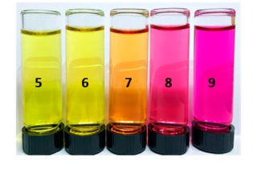
Infection Monitoring
pH sensor: Methacrylated phenol red
FDA approved
skin surface pH 4-6, chronic and infected wounds pH 7.5–8.9
Lowest bacteria detection limit: 100 CFU/mL
S. aureus enters through ulcer, cause osteomyelitis -> bone destruction and amputation.
Polymers (Basel). 2017 Nov; 9(11): 558.
Notes:
Methacrylated - Phenol red: When pH increased, the color of the hydrogel patches will transit from yellow (pH 5-7) to orange (7.4-8), and finally to red (pH 9). (https://www.ncbi.nlm.nih.gov/pmc/articles/PMC6418891/)

Slide 14
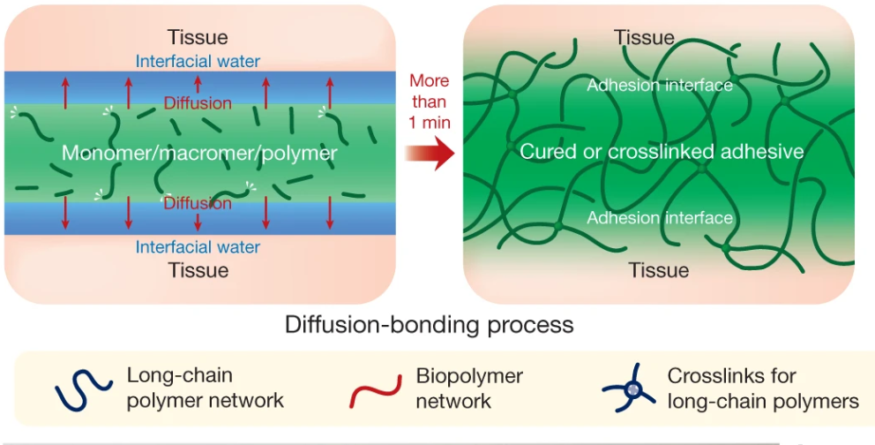
Product details
30% poly(acrylic acid)-NHS ester (self-healing), 0.5% Hyaluronic acid (HA) (biological function), Chitosan (long-lasting properties), 0.25% Methacrylated phenol red (pH indicator), 0.02% LAP (safe cross-linking agent), 69% water
4x more likely for full-healing
Provide an aqueous 3D environment mimicking natural extracellular matrix
FDA approved for use in chronic & diabetic wounds treatments in pre-clinical works
Can swell to 11-fold wt%, sustain release of thrombomodulin >12 hours
Polymers (Basel). 2017 Nov; 9(11): 558. ACS Appl. Mater. Interfaces 2022, 14, 42, 47323–47344

